Slide 1
Providing Peer Support to the
Genetic ALS & FTD Community
2023 Alliance Meeting
Jean Swidler & Cassandra Haddad

Slide 2
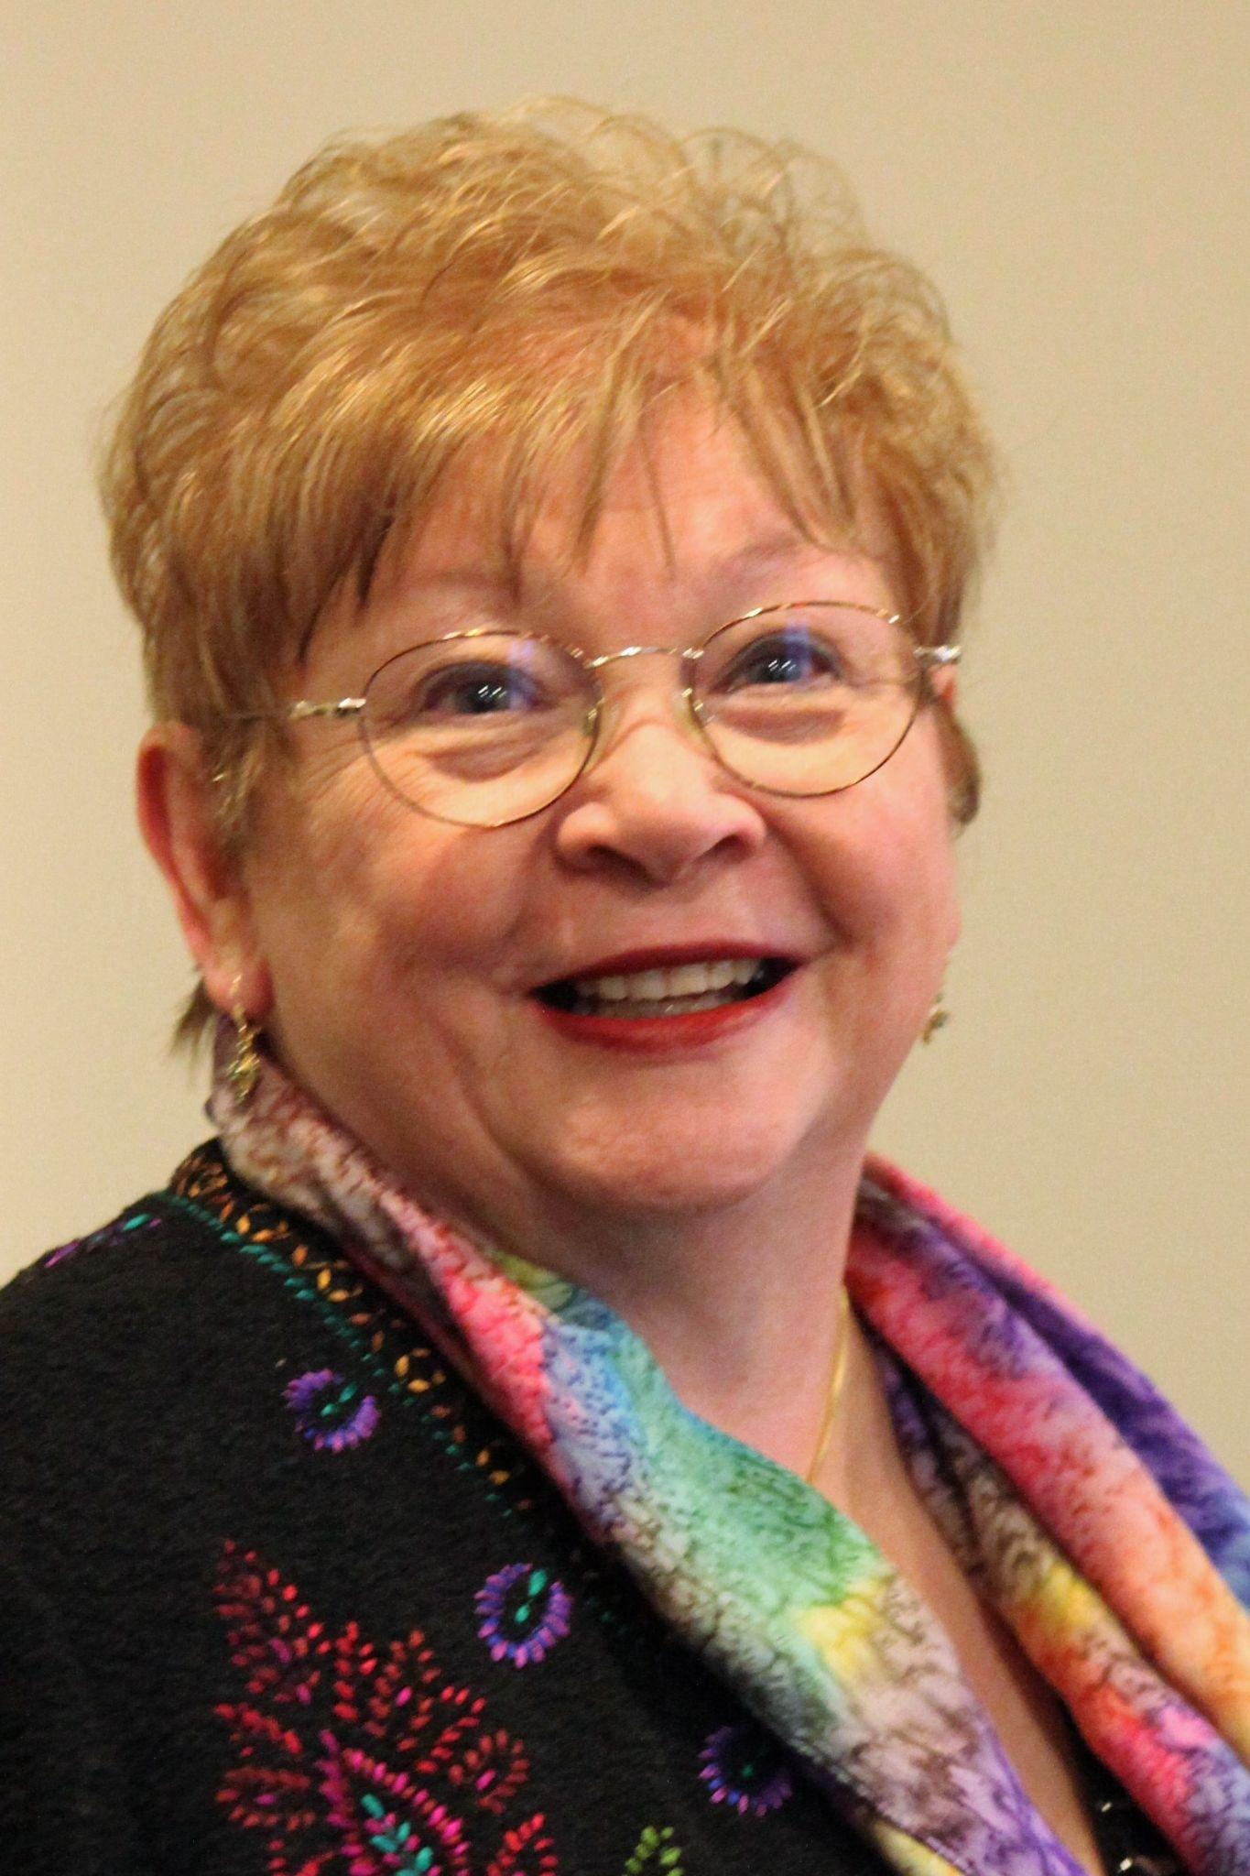
Cassandra Haddad

Slide 3
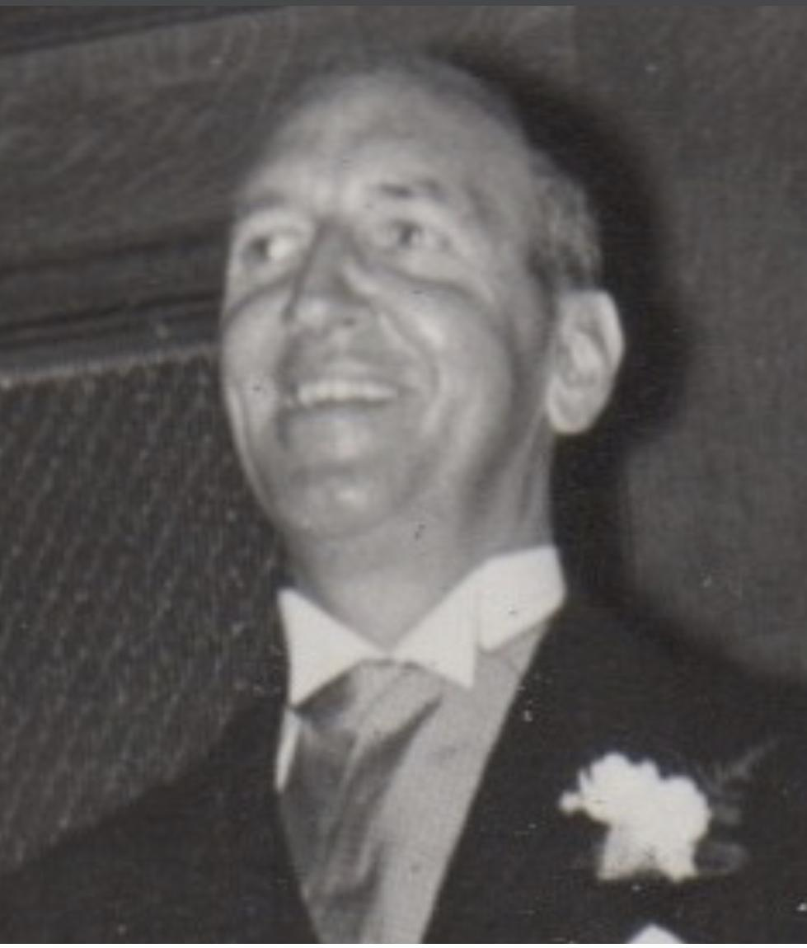
Jean Swidler

Slide 4
Landscape prior to End the Legacy
No dedicated support groups, limited ways to connect.
No representation of the genetic community when issues impacting us were being discussed.
At Risk Community considered a “third rail” situation by many.
Our health in relation to our risk not considered at all.

Slide 5
Models of Patient Led Adult Onset Inherited Disease Communities

Slide 6
End the Legacy - Mission Statement
Mission: The Genetic ALS & FTD community is large and growing. ALS & FTD are terminal conditions, and being at a heightened risk for them can have profound impacts on people and families. We organized Genetic ALS & FTD: End the Legacy to provide educational and support resources to, encourage and promote research about, and advocate for the Genetic ALS & FTD community.

Slide 7
Peer Support
We chose to address having Peer Support as it was identified as a top need.
Brainstorming with experienced mental health professionals and Huntington's Disease social workers led to the development of a peer support hour run by volunteers.

Slide 8
Peer Support Hour
52 sign ups resulted in 26 unique attendees over 5 sessions averaging 10 people per session
Sign-up form includes education on our safety protocol & affirms we are a peer run support effort, not medical care
Facilitated by Linde Jacobs, MAPT carrier and registered nurse

Slide 9
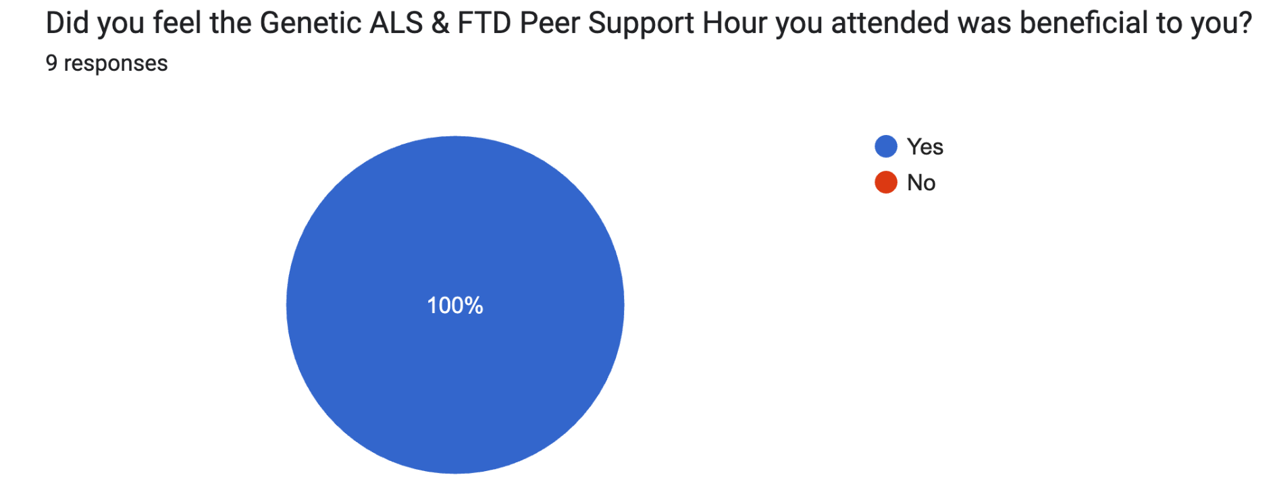
Post Support Hour Survey
Anonymous Survey, Emailed to all Attendees, Answered by 9

Slide 10
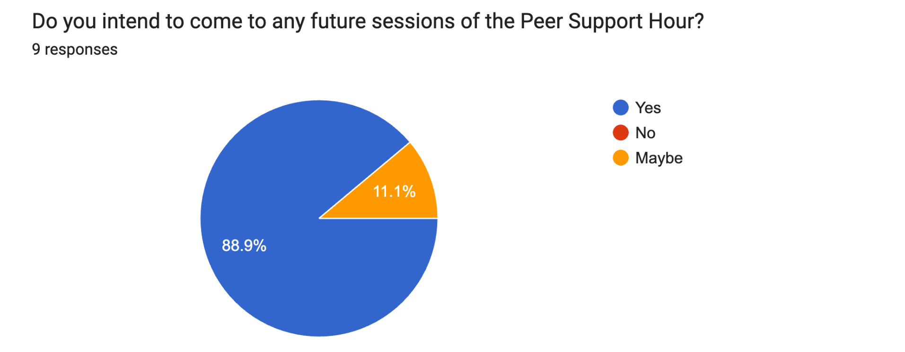
Peer Support Hour Survey

Slide 11
Post Support Hour Survey
“Do you think the ability to connect with others impacted by Genetic ALS & FTD (outside your family) is important? If so, please explain why.”

Slide 12
Post Support Hour Survey
“Yes, I can’t talk to anyone who truly understands in my day to day life - even my siblings and other relatives don't like to engage on it.”
“To be with others in the same position as me is reassuring and makes me feel better about what I’m going through.”
“Yes, family dynamics are sometimes so dynamic that having a neutral group to speak with allows different conversations to occur.”

Slide 13
End the Legacy Membership
Group began on Facebook in 2020, coalesced through 2021 - 2022, officially launched as End the Legacy in January 2023.
Main form of participation is weekly meeting attendance with 20 impacted attendees each week.
55 members participated in 5 or more meetings in the first 6 months of 2023.
Topics include pertinent news to our community; debate on issues impacting us; plans for our work; and plans for how we will engage with industry, regulators, and researchers.

Slide 14
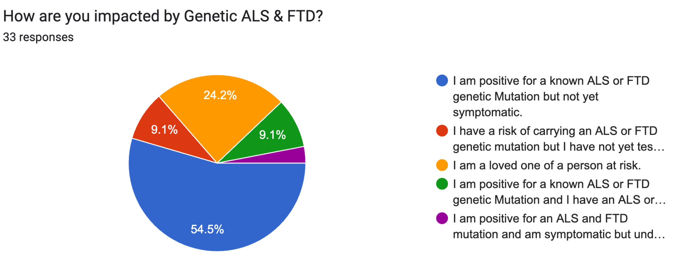
Survey of Most Engaged ETL Members
Anonymous survey of 55 members in June 2023 with 33 Responses

Slide 15
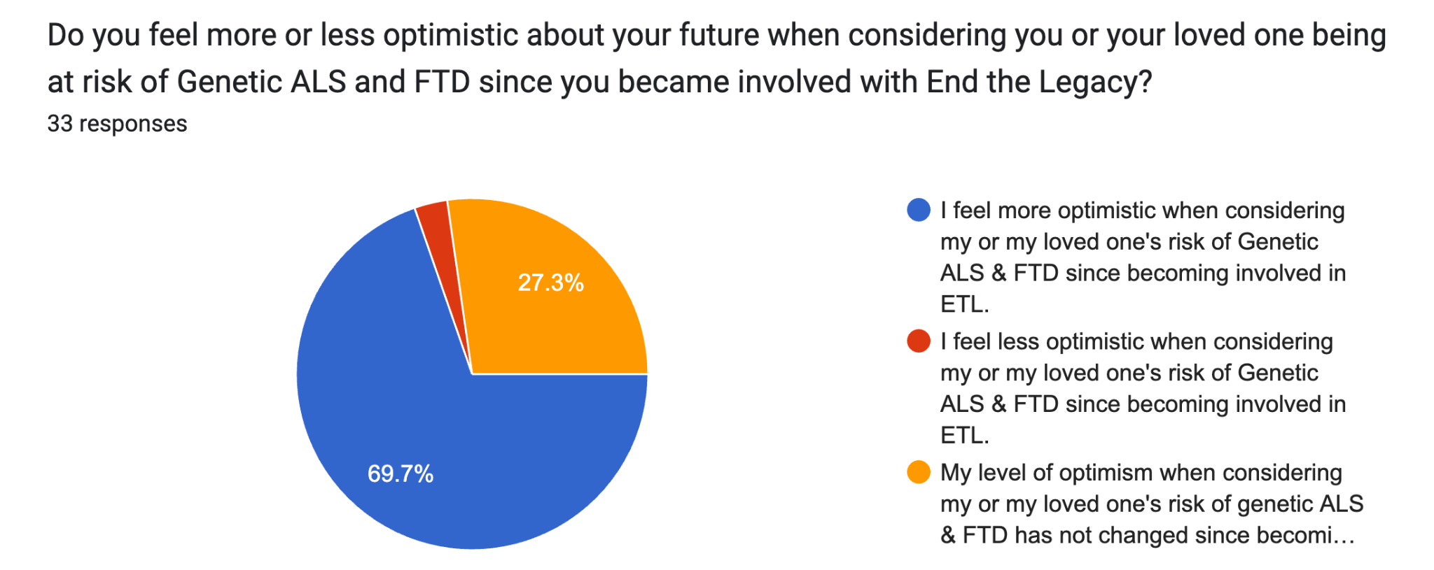
Survey of Most Engaged ETL Members

Slide 16
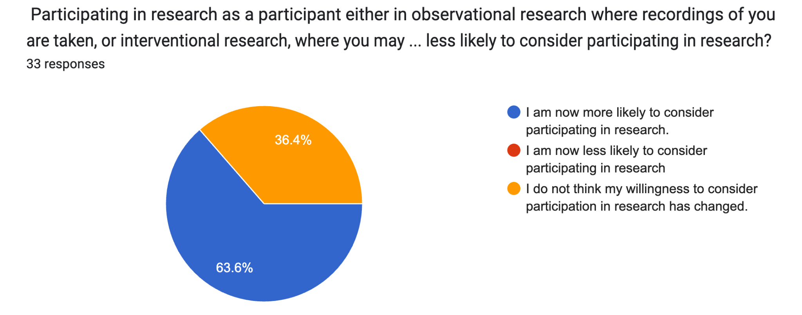
Survey of Most Engaged ETL Members

Slide 17
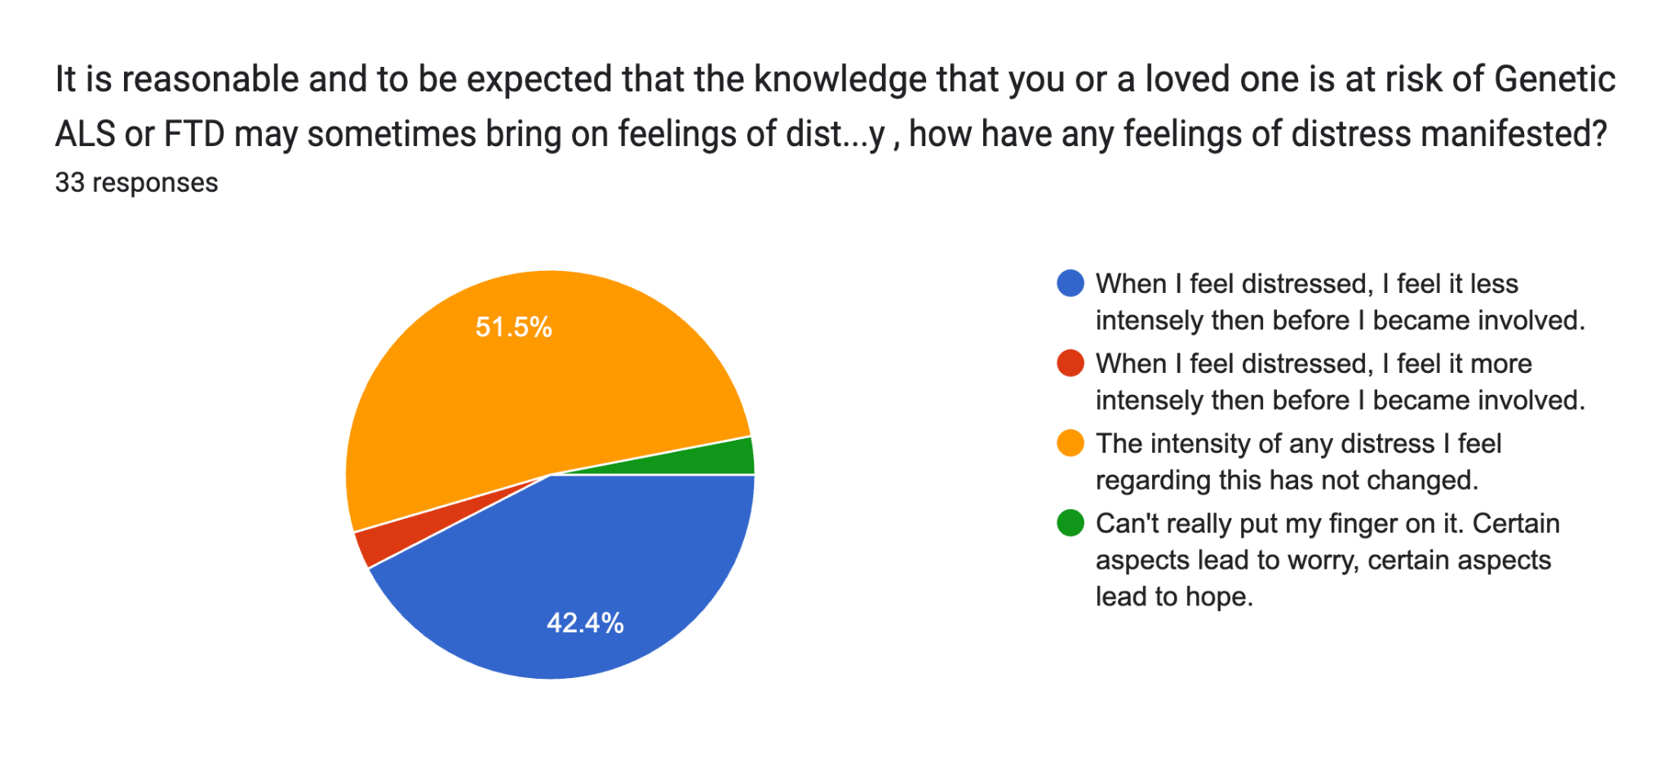
Survey of Most Engaged ETL Members

Slide 18
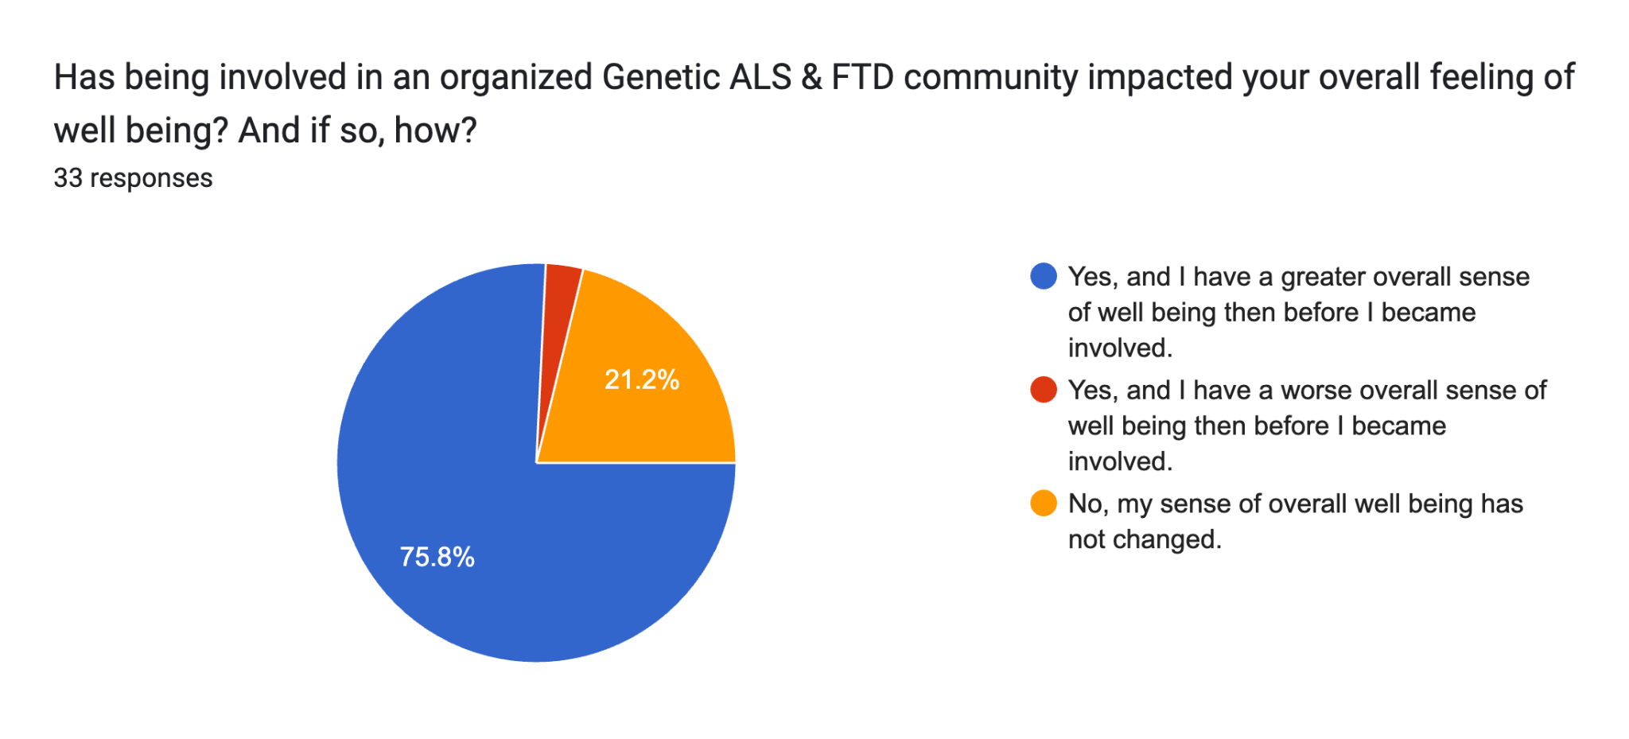
Survey of Most Engaged ETL Members

Slide 19
Survey of Most Engaged ETL Members
“In your own words how has being involved impacted you? What would you tell people about the group?”
Response Themes:
Community & Support
Empowerment & Advocacy
Purpose & Hope
Education & Information

Slide 20
Survey of Most Engaged ETL Members
“Being involved in ETL has helped me feel less isolated in the sea of uncertainty and anguish that familial ALS and FTD brings. The collective motivation, passion, and strength of its members provides desperately needed hope for the future and creates a voice that deserves to be heard loud and clear.”
“The help and support from ETL is immense, being part of a group of gene carriers and those at risk means everything. You don’t need to explain the trauma that you experience because everyone automatically understands.”

Slide 21
Survey of Most Engaged ETL Members
“I found like minded trailblazers that help erase any doubt one might have when it comes to genetic testing. The decision is not taken lightly. Knowing people who can ultimately benefit from such a decision helps.”
“It made me realize how much of an impact I can make in policy, research, and in my ALS community.”

Slide 22
“I no longer feel
alone.”

Slide 23
